Slide 1
Search & Reacquisition of Resident Space Object
Max Heil, Michael Gallagher, Svitlana Pryymachuk, Nathan Savino, Stephanie Small

Slide 2
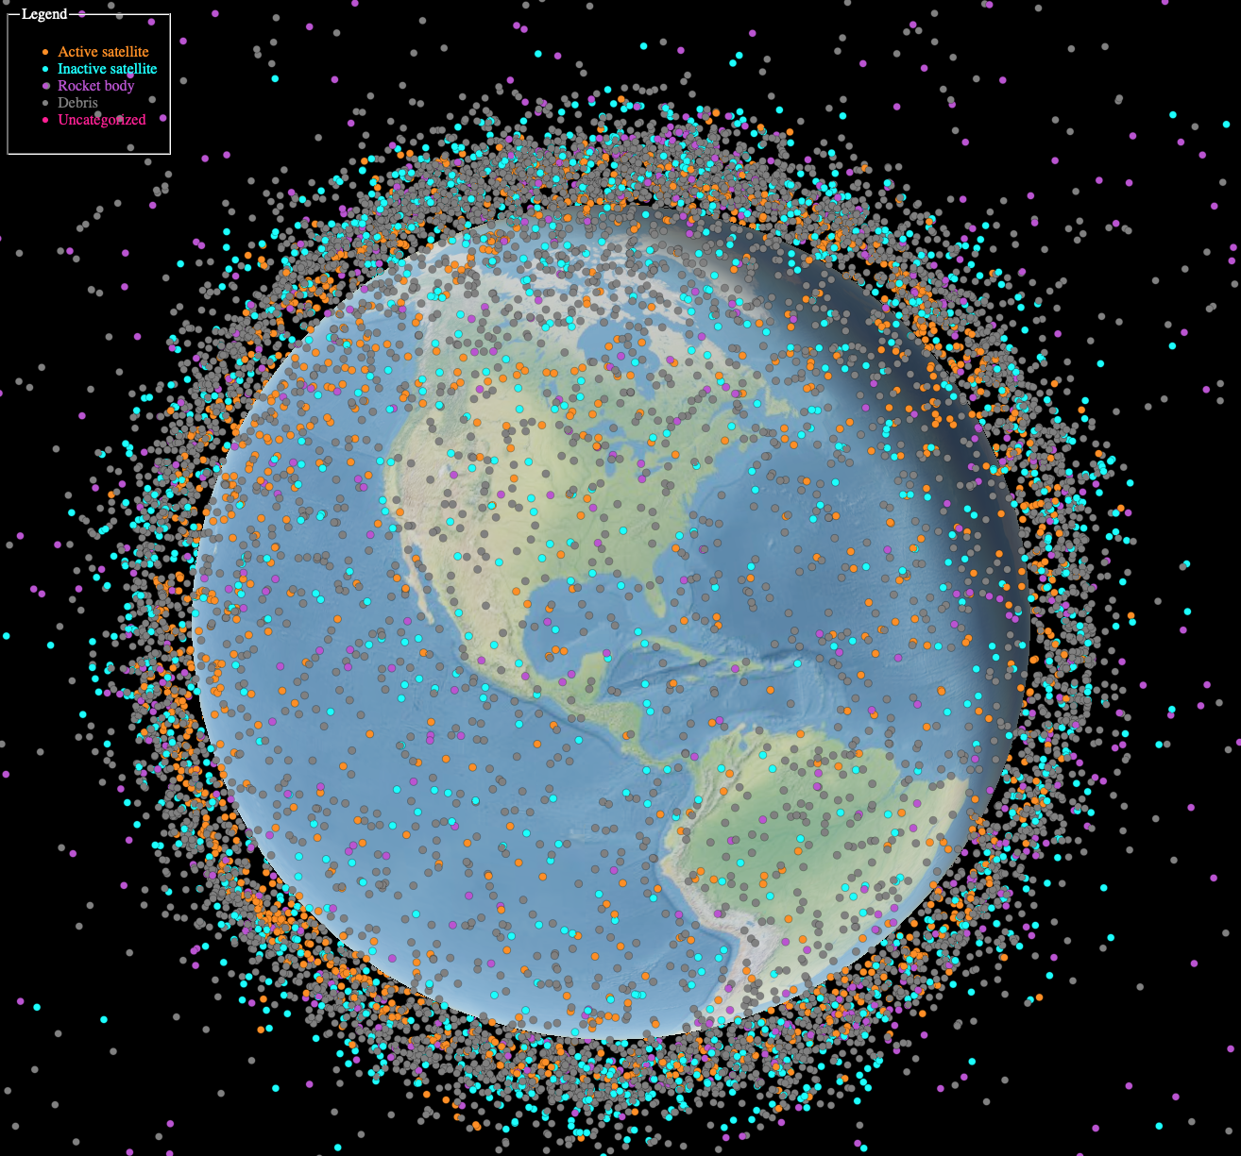
Space Domain Awareness (SDA)
40,000 objects are tracked by space surveillance networks (SSN) [1].
11,000 are active payloads.
The actual number >1 cm estimated to be over 1.2 million [1].
SSN operates a global network of ground-based radars.
Difficult to accurately track each object.
Poses significant national security threat.
Necessity to maintain catalog of each object over time
Anthropogenic Space objects in Low Earth Orbit¹
¹ Image Source: “Space Situational Awareness in Low Earth Orbit,” spacetech-ssa, 2025. https://ibm.github.io/spacetech-ssa/.

Slide 3
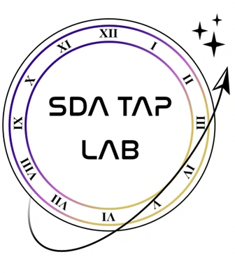
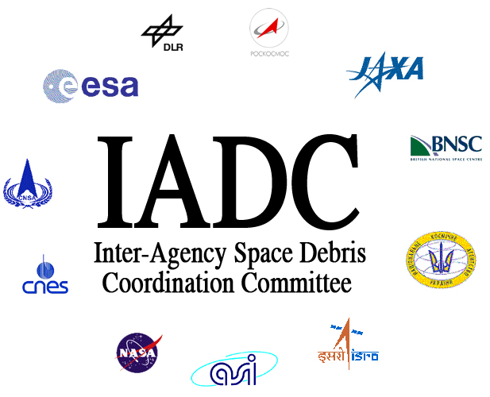
SDA Involvement
Research: "To rapidly predict, detect, track, identify, warn, characterize, and attribute, threats to U.S., commercial, allied, and partner space systems" [2].
Military: “Rapidly detect, warn, characterize, attribute, and predict threats to national, allied, and commercial space systems” [3].
Private Entities: “Precision sensing and orbit determination services” [4].
International: “Exchange information on space debris research activities…and to identify debris mitigation options” [5].
Policymakers: “The rapid growth in the number, sizes, maneuverability, capability, and orbital diversity of objects in the Earth-Moon system will demand much more capable SDA” [6].

Slide 4
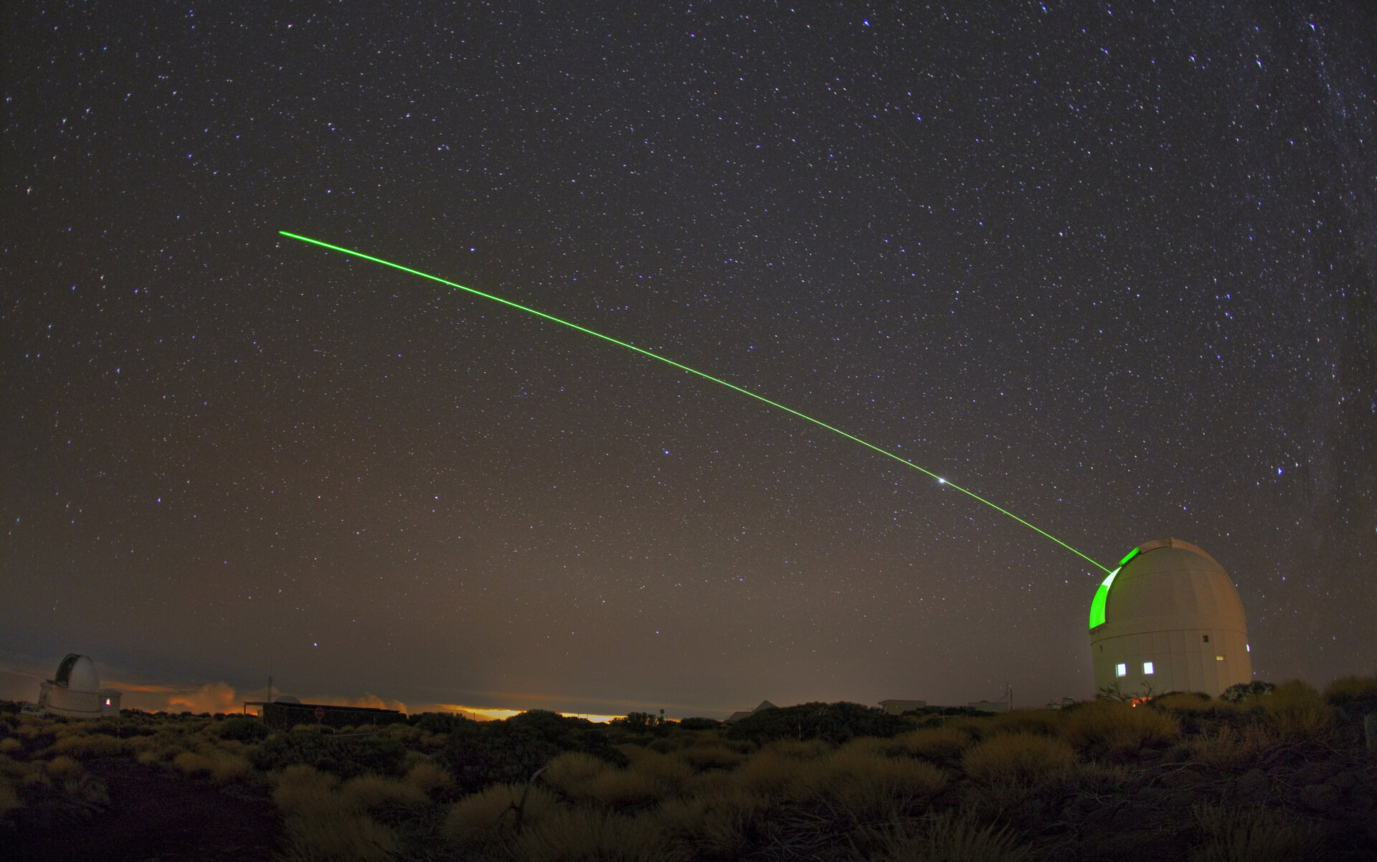
Problem Statement
Problem: SDA still relies heavily on traditional cataloging orbit propagation techniques and antiquated data integration and fusion methods.
Solution:
Develop a multi-stage kill chain to accurately identify, track, and reacquire a space object after an initial sensor reading from a ground-radar using advanced propagation and estimation techniques.
Example of tracking space objects with ground-based systems [7].

Slide 5
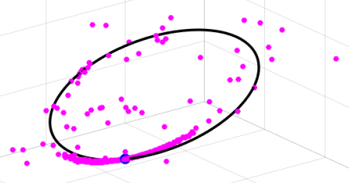
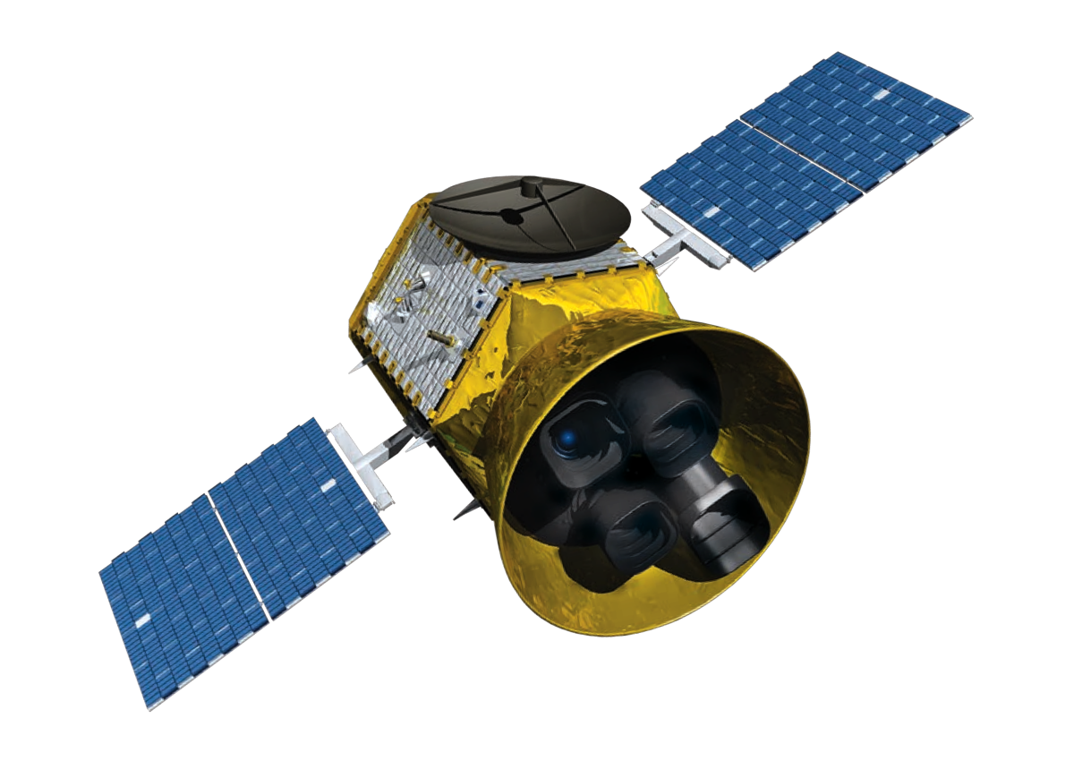
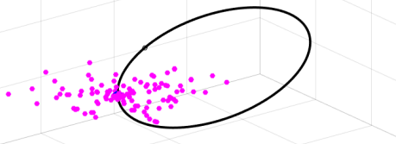
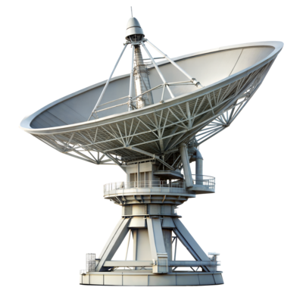
Problem Overview
Evolution after majority of the period:
$$t_{1}=\frac{1}{3}P$$
RSO
All types of orbits are visible
See a few unrealistic orbits
Non-Gaussian evolution is continuing
Evolution some time after initial acquisition:
Initial Sensor 3D Point-Cloud²:
Observation Site Radar Information:
Azimuth
Elevation
Range
Point cloud no longer looks Gaussian
Equatorial Plane
Gaussian Point-Cloud at initial time
Inclination, $i$
$$t_{2}=\frac{2}{3}P$$
² Point-Cloud is exaggerated to show detail

Slide 6
Problem Overview

Slide 7
Objectives
Goal: Successfully recapture an initially acquired space object on a second pass.
Build multi-stage kill chain using:
Artificial Intelligence (AI) for launch detection & rocket classification
Initial Orbit Determination (IOD)
Gaussian Least Squares Differential Correction (GLSDC) for orbit refinement
Adaptive Monte Carlo (AMC) to propagate point-cloud forward in time
Kalman Filtering for probabilistic comparison of measurements with prediction
Identify Launch & Classify Rocket
Object in Orbit
Produce Single Pass IOD from Sensor Data
Use GLSDC for Orbit Determination (OD)
Model Probalistic Distribution of Future States Using AMC
Kalman Filtering
Determine Reacquisition
Simulate Launch
RSO Acquired
Refine
Propagate
Filter
Compare

Slide 8
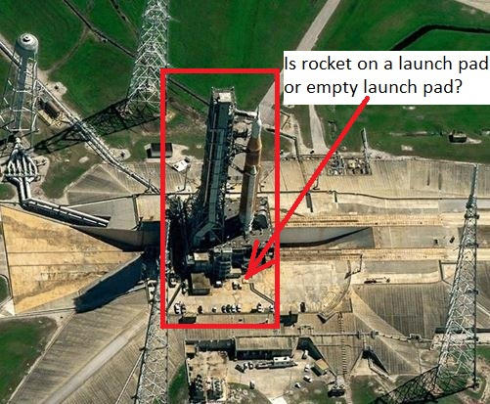
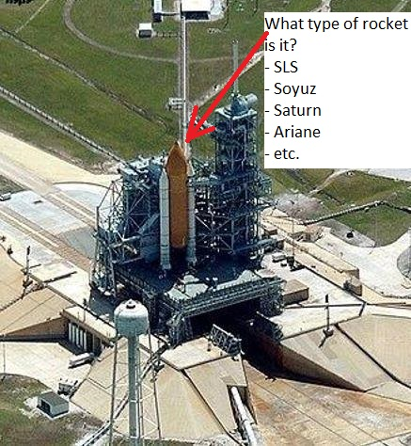
Phase 1 – Launch Detection using AI
Machine Learning model to recognize if a launch pad has a rocket on it or empty.
Machine Learning model to classify the rocket body after detection.

Slide 9
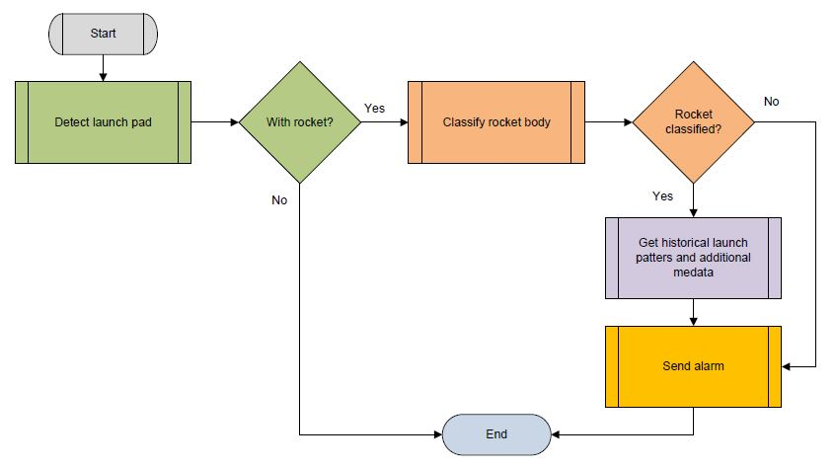
Launch Detection using AI: Serving Flow

Slide 10
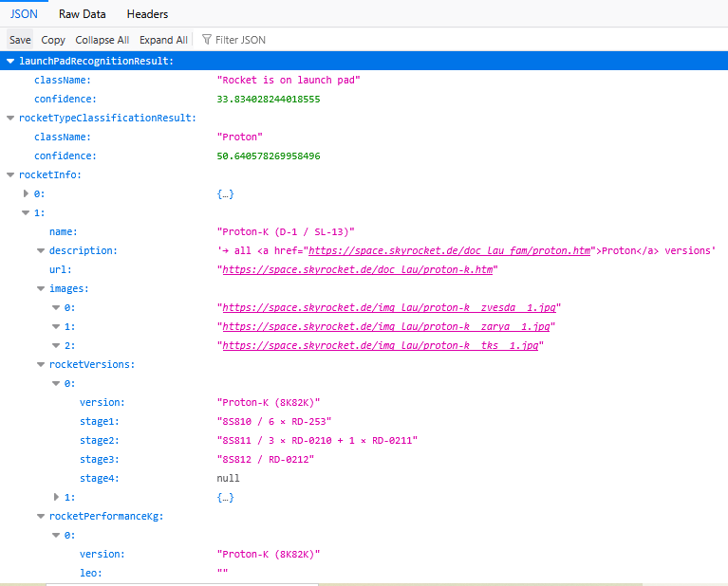
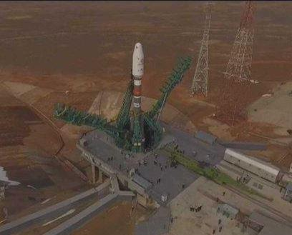
Launch Detection using AI: Application Output

Slide 11
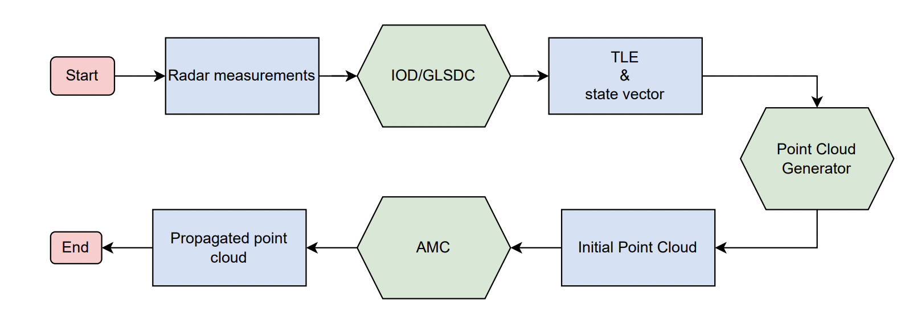
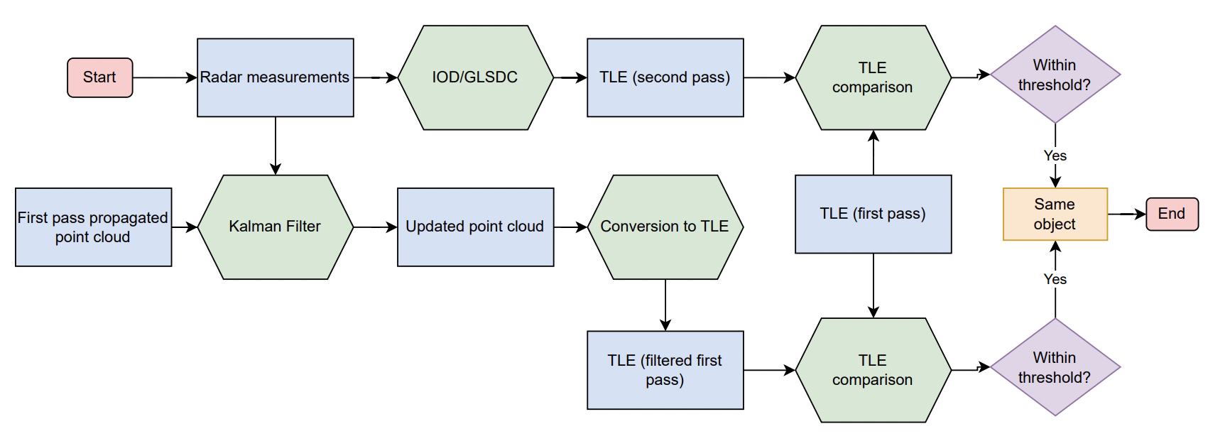
Process
First-Pass
Second-Pass

Slide 12
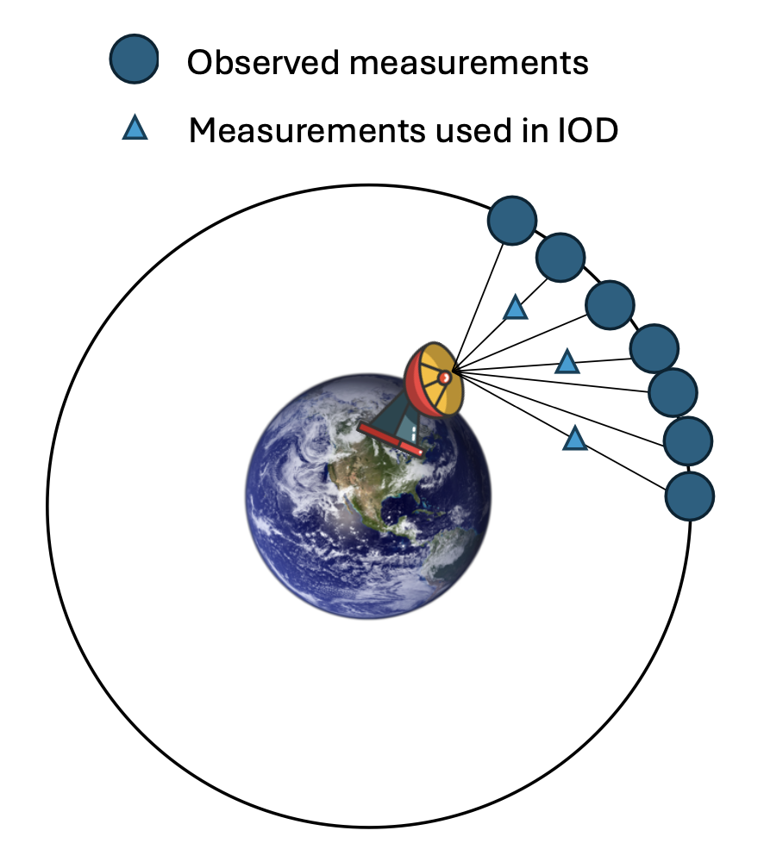
Phase 2 – IOD
Measurement system cannot get required six independent measurements simultaneously
Requires a series of observations to determine the orbit
Observations are generated based on geodetic latitude and longitude of observation site.
Gauss Angles-Only Method using 3 observations
Estimates position and velocity of object from noisy azimuth and elevation measurements
Gives an initial estimate for the true position and velocity of the RSO
$r$ and $v$ give the initial orbital elements (OE)

Slide 13
IOD Algorithm
Given 3 times $(t_{1},t_{2},t_{3})$ and the azimuth $(A)$ and elevation $\left(a\right)$ angles:
Get determinant values from observation geometry
$D_{ij}=R_{i}({\hat{ρ}}_{j}×{\hat{ρ}}_{k})$ for $ij=1, 2, 3$ where ${\hat{ρ}}_{}$ is the topocentric direction cosine vector
Find A and B coefficients to compute slant range $ρ_{2}$
$ρ_{2}=A+\frac{μB}{r_{2}^{3}}$ where $μ$ is the gravitational parameter of Earth
Compute $r_{2}={\left(A+\frac{μB}{r_{2}^{2}}\right)}^{2}+2E\left(A+\frac{μB}{r_{2}^{2}}\right)+R_{2}^{2}$
Need to expand and rearrange to eighth-degree polynomial: $x^{8}+ax^{6}+bx^{3}+c=0$ where $x=r_{2}$
$a=−\left(A^{2}+2AE+R_{2}^{2}\right)$ , $b=−2μB(A+E)$ , $c=−μ^{2}B^{2}$
Use Newton’s method to find roots: $x_{i+1}=x_{i}−\frac{x_{i}^{8}+ax_{i}^{6}+bx_{i}^{3}+c}{8x_{i}^{7}+6ax_{i}^{5}+3bx_{i}^{2}}$
Choose best root of $r_{2}$ and compute ranges
Find radius vector & calculate Lagrange coefficients $(f,g)$
Calculate the velocity at obs. 2 and use $(r_{2},v_{2}$) to find orbital elements

Slide 14
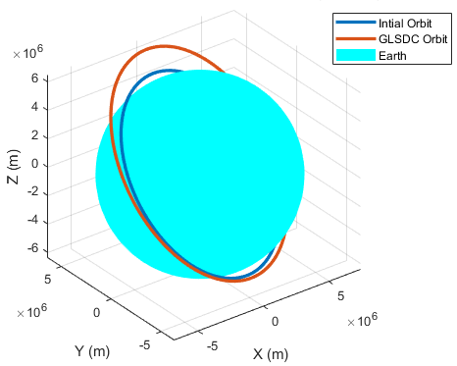
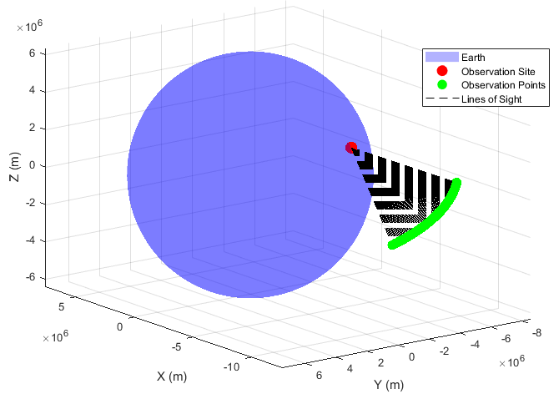
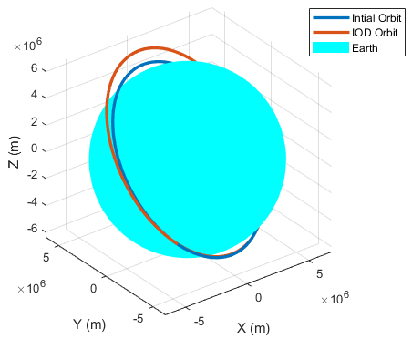
IOD ISS Test Case
Observation points as seen from radar on Earth
Comparison of “true” and IOD orbits
First Pass
Second Pass

Slide 15
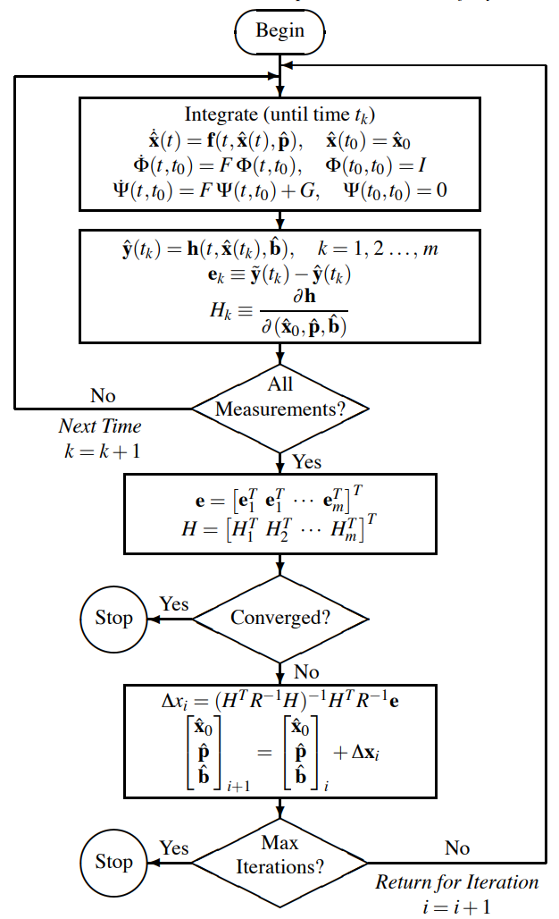
Phase 3 – Orbit Refinement (GLSDC)
Uses iterative least squares correction to refine initial orbit determination
Minimizes error between predicted orbit (IOD) and observed measurements
Incorporates full dynamics via state transition matrix $Φ\left(t,t_{0}\right)$
Builds Jacobian $(H)$ to relate measurement sensitivity to state
Converges when residual error is below threshold
If not converged, updates states using:
$Δx={\left(H^{T}R^{−1}H^{−1}\right)}^{−1}H^{T}R^{−1}e$

Slide 16
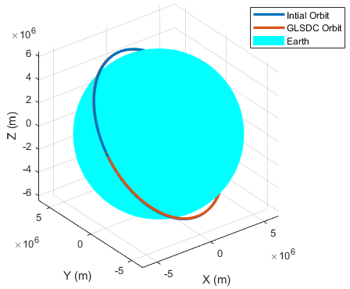
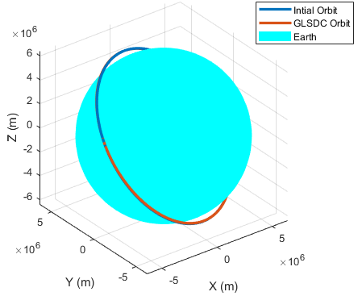
GLSDC ISS Test Case
Comparison of “true” and GLSDC orbits
First Pass
Second Pass

Slide 17
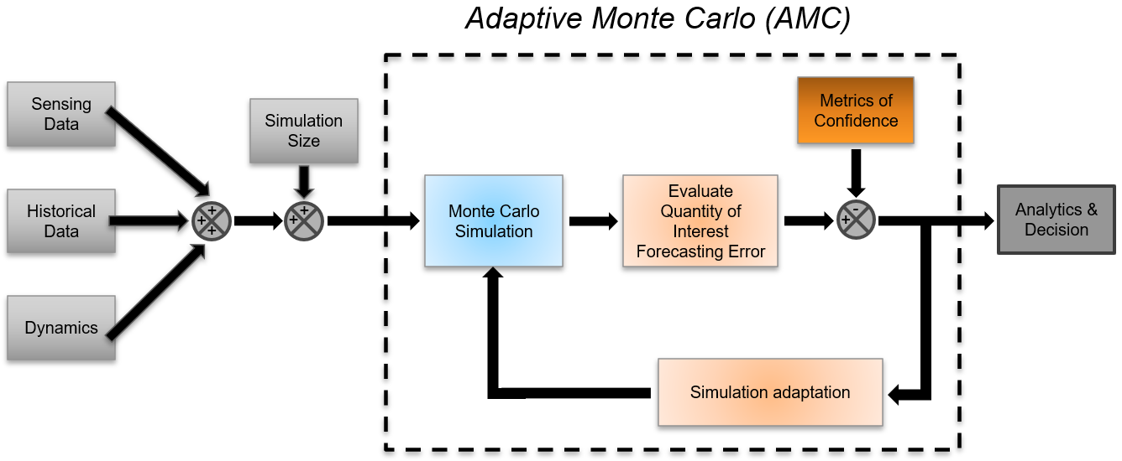
Phase 4 – Propagate Point Cloud (AMC)
Represent the initial sensor uncertainty as a point cloud
Propagate point cloud forward in time
Feed point cloud into AMC tool to propagate orbits forward in time
Bootstrapping algorithm to create a pseudo-mean and recalculate the standard deviation
More particles can be created if standard deviation is too large
Runs until the output falls within the bounds of an expected standard deviation

Slide 18
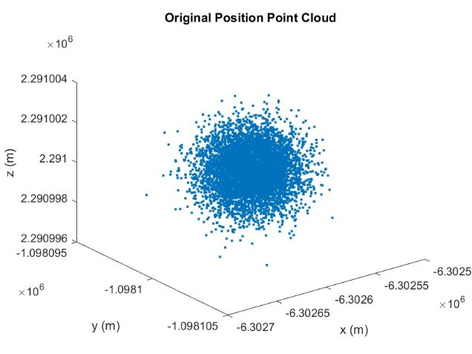
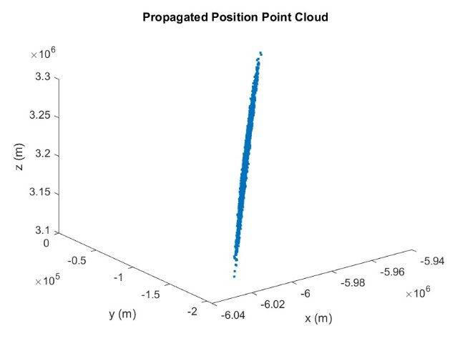
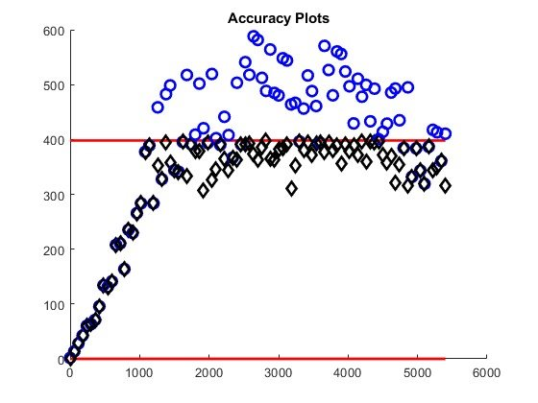
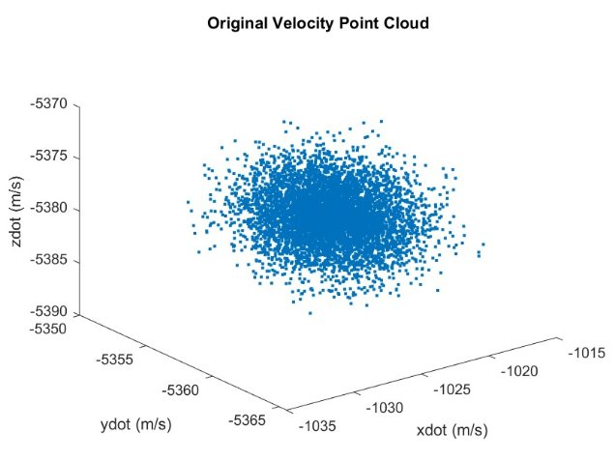
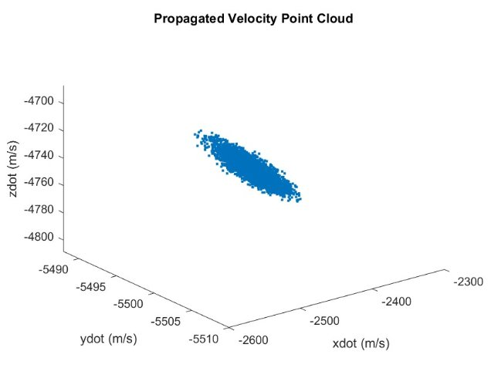
AMC ISS Test Case
Accuracy increases with the number of particles

Slide 19
Phase 5 – Filtering (KF)
Refine the predicted orbit by fusing propagated and observed data
Use a Discrete-Time Linear Kalman Filter
Inputs:
Propagated mean and covariance from AMC
Second-pass state estimate from GLSDC
Sensor noise matrix
Outputs:
Updated state vector
Updated covariance matrix
Ultimately reduces uncertainty and noise
Provide a more accurate state vector for final reacquisition comparison

Slide 20
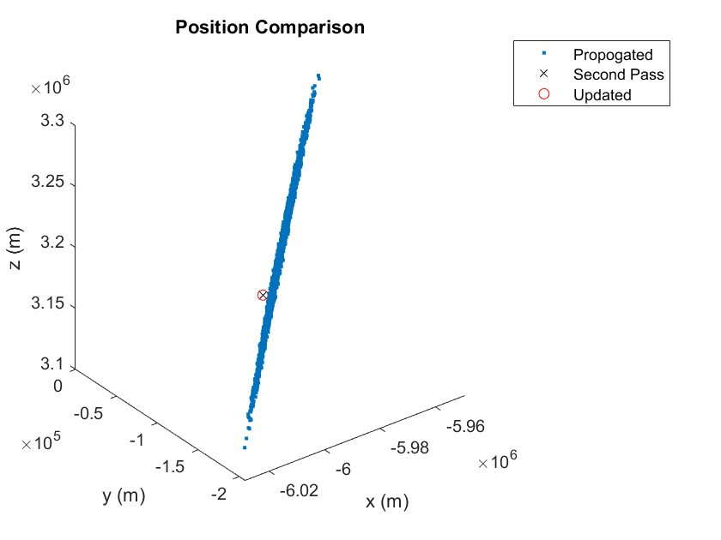
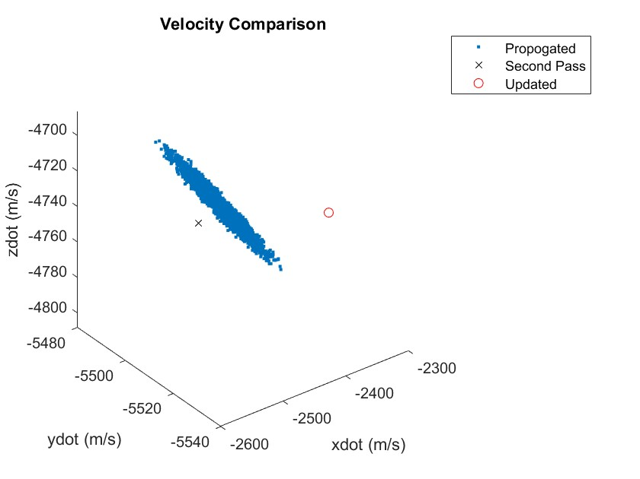
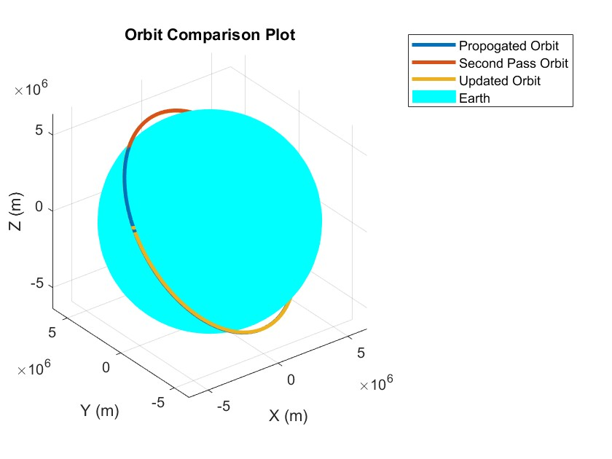
Filtering ISS Test Case
After implementing the Kalman Filter, the updated state vector seems appropriate
Overcorrection for velocity – point of future work
Orbit comparison shows all three orbits are nearly indistinguishable

Slide 21
Conclusions
Key Takeaways:
Developed a multi-stage reacquisition framework for RSOs
Successfully reacquired the object in a simulated two-pass ISS scenario
Limitations:
Artificially generated sensor data
Launch classification accuracy needs improvement
Impact:
Demonstrated feasibility of automated space object reacquisition
Scalable to real-world SSN
Identify Launch & Classify Rocket
Object in Orbit
Produce Single Pass IOD from Sensor Data
Use GLSDC for Orbit Determination (OD)
Model Probalistic Distribution of Future States Using AMC
Kalman Filtering
Determine Reacquisition
Simulate Launch
RSO Acquired
Refine
Propagate
Filter
Compare

Slide 22
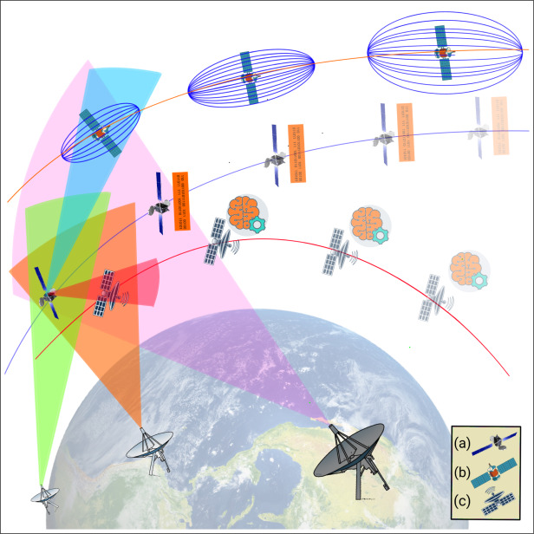
Future Work
High Priority:
Collect data-driven sensor feedback to improve detection process
Employ SSN into observations
Implement intent characterization after reacquisition
Low Priority:
Apply generalized theory to maneuver detection with relative spacecraft motion
Extend kill-chain to maneuvering or low-thrust space objects
Explore nonlinear or adaptive Kalman filters (EKF/UKF)
Automate full end-to-end reacquisition pipeline
Showcase of SSN orbit determination subcategories [8].

Slide 23
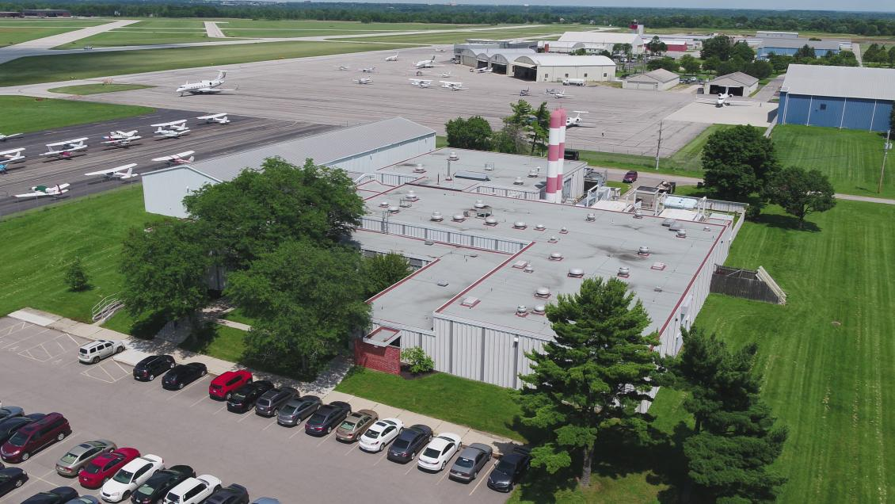
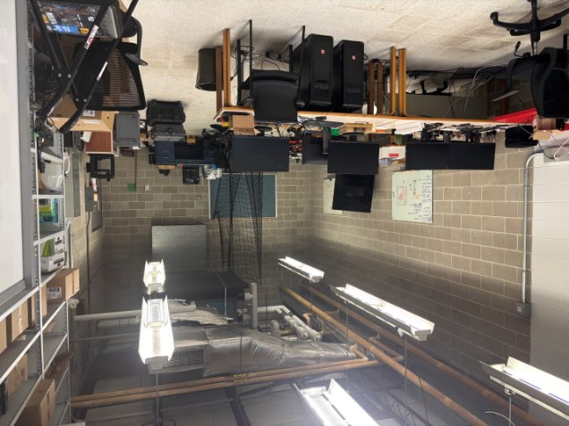
Acknowledgements
Dr. Mrinal Kumar, MAE
Dr. Brian Ritchie, MAE
Rondale Balo, PhD AE
Sriram Narayanan, PhD AE
Troy Krizak, PhD AE
Laboratory for Autonomy in Data-Driven and Complex Systems (LADDCS)
PointPro USA in conjunction with SDA TAP Lab
Ohio State University Aerospace Research Center (ARC)
LADDCS Laboratory

Slide 24
References
[1] “ESA Space Environment Report 2025,” Esa.int, 2025. https://www.esa.int/Space_Safety/Space_Debris/ESA_Space_Environment_Report_2025?utm_source=chatgpt.com.
[2] S.T Lab, "SDA Tap Lab," SDA TAP LAB, https://sdataplab.org/ (accessed Oct. 28, 2024).
[3] “Space Domain Awareness & Combat Power,” www.ssc.spaceforce.mil. https://www.ssc.spaceforce.mil/Program-Offices/Space-Domain-Awareness-Combat-Power.
[4] Kratos Defense & Security Solutions, “Tracking & Maneuver,” Kratosdefense.com, 2025. https://www.kratosdefense.com/systems-and-platforms/space-systems/military-and-government/space-domain-awareness/tracking-and-maneuver.
[5] “IADC,” www.iadc-home.org. https://www.iadc-home.org/what_iadc.
[6] J. Shaw and S. Kirkpatrick, “Future Space Domain Awareness Needs for National Security Space,” Csis.org, 2024. https://www.csis.org/analysis/future-space-domain-awareness-needs-national-security-space.
[7] “Using Lasers to Track Space Debris,” European Space Agency. https://www.esa.
[8] S. Kazemi, N. L. Azad, K. A. Scott, H. B. Oqab, and G. B. Dietrich, ‘Orbit determination for space situational awareness: A survey’, Acta Astronautica, vol. 222, pp. 272–295, 2024.

